Slide 1
CHAPTER 3 The Ethics and Politics of Social Research

Slide 2
Chapter Outline
Introduction
Ethical Issues in Social Research
Two Ethical Controversies
The Politics of Social Research
Chapter Summary
Questions

Slide 3
Ethical Issues in Social Research (slide 1 of 7)
Ethical (Webster’s) – Conforming to the standards of conduct of a given profession or group.
Voluntary Participation
No one should be forced to participate.

Slide 4
Ethical Issues in Social Research (slide 2 of 7)
No Harm to the Participants
People being researched should never be injured (physically, mentally, emotionally, socially, psychologically).

Slide 5
Ethical Issues in Social Research (slide 3 of 7)
Informed Consent – A norm (and legal form) to which participants agree (and sign). This acknowledges that their voluntary participation in a research project is based on their full understanding of the possible risks involved.

Slide 6
Ethical Issues in Social Research (slide 4 of 7)
Anonymity and Confidentiality
Anonymity – Guarantee in a research project when neither the researchers nor the readers of the findings can identify a given response with a given respondent.
Confidentiality – Guarantee when the research can identify a given person’s responses but promises not to do so publicly.

Slide 7
Ethical Issues in Social Research (slide 5 of 7)
Deception
Deception within social research needs to be justified by scientific or administrative concerns.
Debriefing – Interviewing participants after their participation is complete to learn about their experience in the project.

Slide 8
Ethical Issues in Social Research (slide 6 of 7)
Analysis and Reporting
Ethical obligation to colleagues in the scientific community.
All results must be reported (positive and negative), if related to analysis.
All limitations and failures of a study must be admitted.

Slide 9
Ethical Issues in Social Research (slide 7 of 7)
Institutional Review Boards (IRBs) – A panel of faculty/experts who review all research proposals involving human subjects so that they can guarantee that the subjects’ rights and interests will be protected.

Slide 10
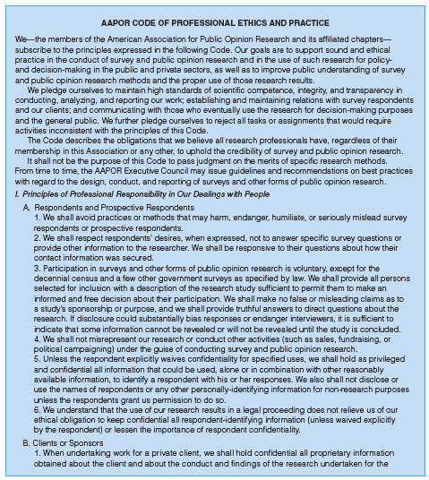
Figure 3-1
Code of Ethics of the American Association for Public Opinion Research
Source: Material taken from the AAPOR Code of Ethics and Practice. Accessible at http://www.aapor.org/AAPOR_Code_of_Ethics/4249.htm, May 2010.

Slide 11
Two Ethical Controversies (slide 1 of 2)
Trouble in the Tearoom – Laud Humphreys
Studied homosexual activities in public restrooms in parks
Researcher became interested in the lives of participants
Researcher volunteered to become “watchqueen”
Researcher collected personal information about the participants (license numbers of cars)
Which ethical issues are in question?

Slide 12
Two Ethical Controversies (slide 2 of 2)
Observing Human Obedience – Stanley Milgram 
Participants imitated a laboratory-based World War II controversy
Participants were assigned job of “teacher” – to teach a list of works to the “pupil.” If the pupil got the word wrong, the teacher would administer increasing levels of shocks to the pupil.
Which ethical issues are in question?
Zimbardo Prison Experiment 

Slide 13
The Politics of Social Research (slide 1 of 5)
The ethics of social research deal mostly with the methods employed.
Political issues tend to center on the substance and use of research.
There are no formal codes of acceptable political conduct, while there are formal codes of conduct for social research.

Slide 14
The Politics of Social Research (slide 2 of 5)
Objectivity and Ideology
Science achieves objectivity through intersubjectivity.
Weber (1925): value-free sociology - needs to be unencumbered by personal values if it is to make a special contribution to society.

Slide 15
The Politics of Social Research (slide 3 of 5)
Race
Sexual research
Census

Slide 16
The Politics of Social Research (slide 4 of 5)
Politics with a Little “p”
Social research in relation to contested social issues cannot remain antiseptically objective.

Slide 17
The Politics of Social Research (slide 5 of 5)
Politics in Perspective
Science is not untouched by politics.
Science does proceed in the midst of political controversy and hostility.
An awareness of ideological considerations enriches the study and practice of social research methods.
Whereas researchers should not let their own values interfere with the quality and honesty of the research, this does not mean that researchers cannot or should not participate in public debates.

Slide 18
Chapter Summary
Be able to identify and describe the key ethical issues in social research.
Explain why the research of Laud Humphreys and Stanly Milgram were so ethically controversial.
Give examples of how political issues can influence the conduct of social research.

